Slide 1
Dog Venues in Boston, MA
Final Capstone Project

Slide 2
Introduction
More dogs have been adopted or found foster homes have increased since the pandemic started
Dog owners should have access to location data for venues that cater to dogs or pets
Veterinary care
Pet stores
Park
Use a location map to find dog venues

Slide 3

Data
Using Foursquare API data
Extract the following categories to identify dog venues:
Dog Runs
Outdoors
Parks
Pet Services
Pet Stores
Playgrounds
Veterinarians / Medical Center
Spas
Lake
Beach

Slide 4
Methodology
Search queries for the categories in previous slide
Create a dataframe for each of the search query results
Compile all the resulting dataframes
Create a map of dog venues around Boston

Slide 5
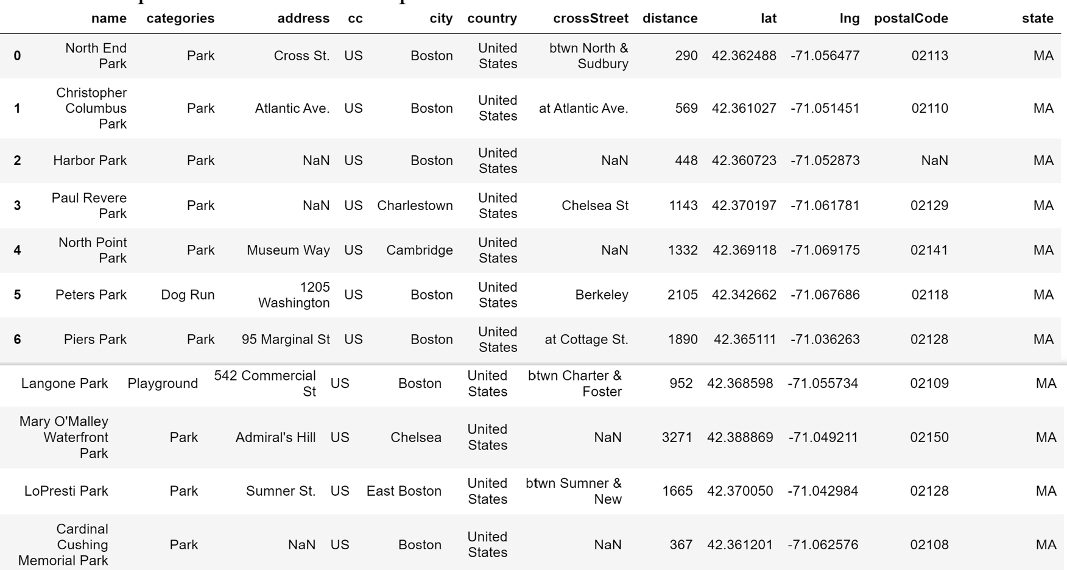
Sample of Results

Slide 6
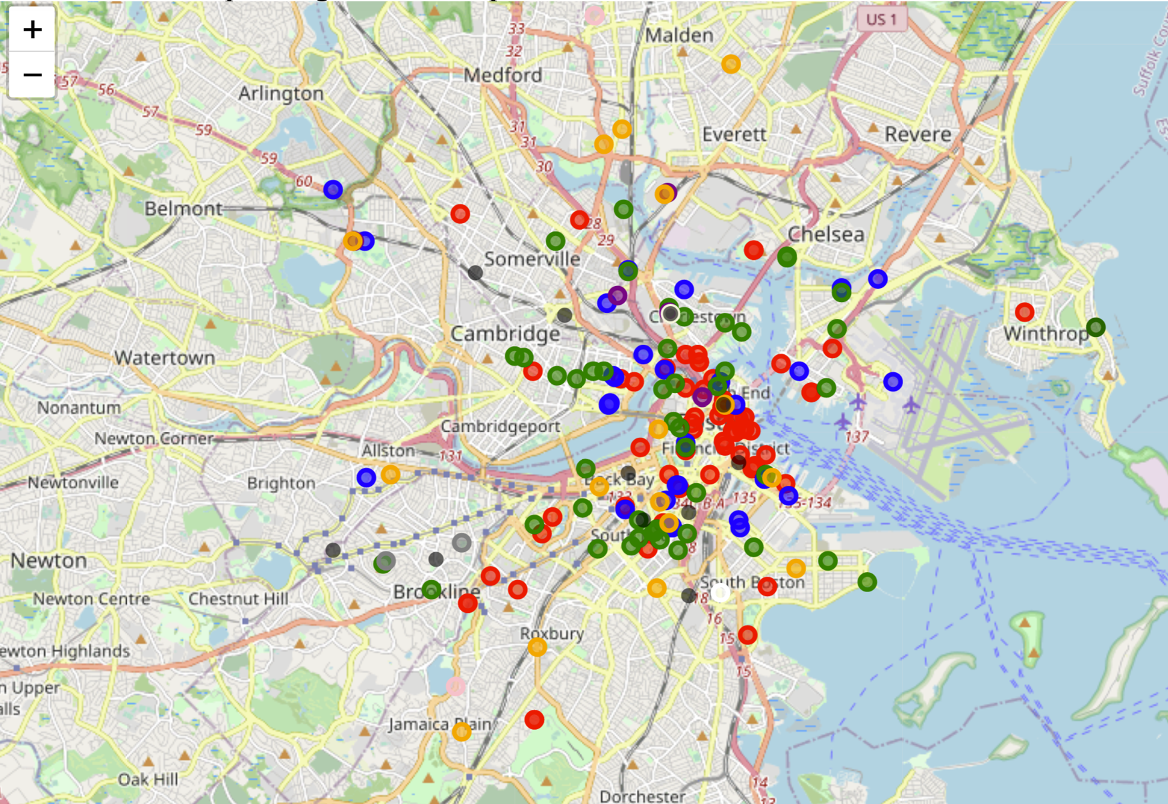
Map
Orange marker = Pet Store
Red marker = Park
Blue marker = Dog Run
Green marker = Playground
Purple marker = Veterinarian
Gray marker = Great Outdoors
Dark purple marker = Pet Services
Beige maker = Spa
White marker = Medical Center
Pink marker = Lake
Dark green = Beach

Slide 7
Conclusion
Map shows dog venues scattered across Boston, MA
Dog owners can map out route of how to go to a venue or which venues to visit based on proximity
Saves time for dog owners from searching the internet for groomers, veterinarians, pet stores, etc.

